Slide 1
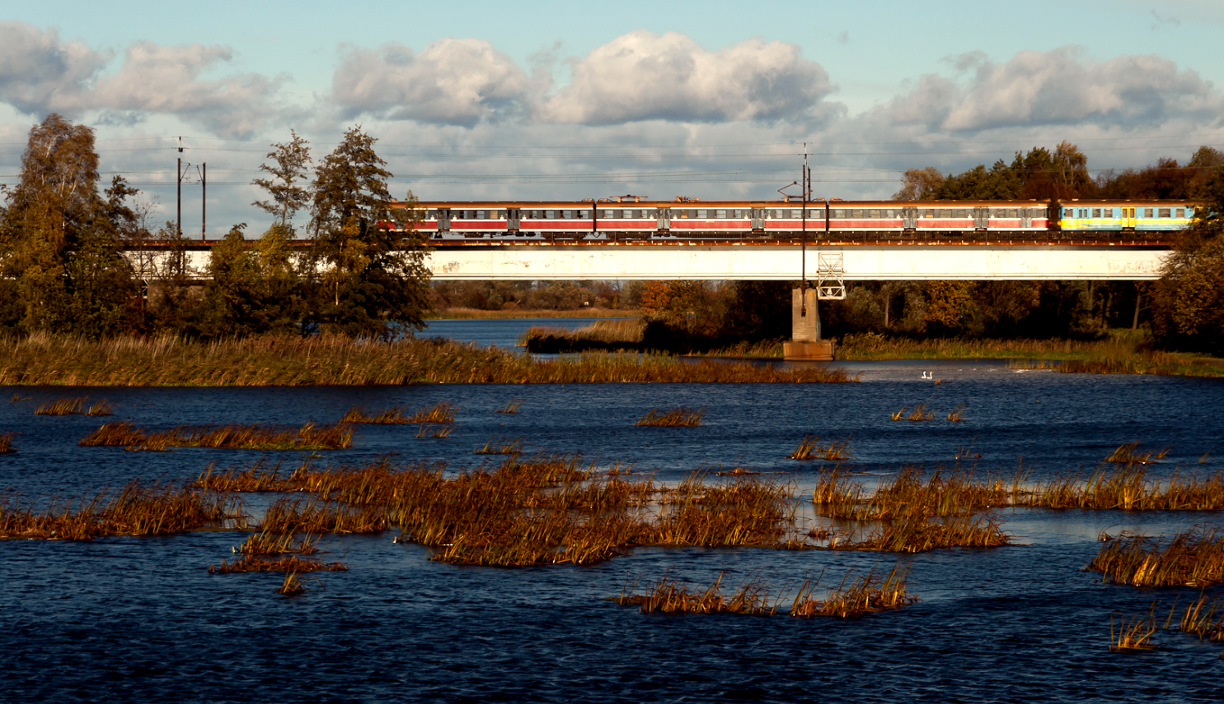


Demand modelling – requirements of the EU
Paul Riley
EIB-JASPERS
Warsaw, 8th May 2019

Slide 2
Content of presentation on demand modelling
Conclusions
Why ?
1. Emphasis on robust demand analysis in legislation and guidance
2. What is demand analysis used for ?
What is needed ?
3. What modelling do I need ?
4. Data, surveys and evidence
5. Forecasting the Future
Implementation
6. Procuring, operating and maintaining models

Slide 3

Content of presentation
Conclusions
Why ?
1. Emphasis on robust demand analysis in legislation and guidance
2. What is demand analysis used for ?
What is needed ?
3. What modelling do I need ?
4. Data, surveys and evidence
5. Forecasting the Future
Implementation
6. Procuring, operating and maintaining models

Slide 4

1. Needs of EC 2014-2020 (1)
Key input to CBA benefits and planning
Guide and demonstrate value for money viable solutions
Avoid :
Underperformance, sub-optimality
Under and over-dimensioning
Emphasis on robust demand modelling in 2014-2020

Slide 5
1. Needs of EC 2014-2020 (2)
CBA legislation 2014-2020 (IA 207/215 annex III)
Demand analysis quantifies the social need for an investment, document :
Current demand by use of models and actual data
Forecast demand from macro-economic and sector forecasts and considering demand elasticities to relevant determinants
Supply side aspects and network effects

Slide 6

1. Needs of EC 2014-2020 (3)
CBA guidance 2014-2020
2.6.1 Reflects annex III of legislation
3.5.1 - Factors influencing demand analysis
3.5.2 - Hypotheses, methods and inputs
3.5.3 – Analysis outputs / inputs into CBA
Transport modelling expected
Transparency of method and assumptions

Slide 7
1. Needs of EC 2014-2020 (4)
Funding application legislation 2014-2020
IQR Criteria (IA 480/214) 4.1 :
Demand analysis - reliable and based on realistic estimates reflecting trends and developments
Funding application documentation required (IA 207/215 – Annex II D.1)
Methodology, assumptions and baselines
Historical/current/forecast demand
Forecast per option
Supply side aspects, network effects

Slide 8
1. Needs of EC 2021-2027
Draft Proposal for a REGULATION OF THE EUROPEAN PARLIAMENT AND OF THE COUNCIL 2021-2027 : ANNEX IV– Article 1 1(1)
Thematic enabling conditions applicable to ERDF and CF :
Developing a sustainable, climate resilient, intelligent, secure and intermodal TEN-T,
Sustainable, climate resilient, intelligent and intermodal national, regional and local mobility, including improved access to TEN-T and cross-border mobility :
Comprehensive transport planning at the appropriate level
Includes economic justification of the planned investments, underpinned by demand analysis and traffic modelling
In our view this demand analysis principle applies to the whole planning – project concept development cycle

Slide 9

Content of presentation
Conclusions
Why ?
1. Emphasis on robust demand analysis in legislation and guidance
2. What is demand analysis needed for ?
Implementation
6. Procuring, operating and maintaining models
What is needed ?
3. What modelling do I need ?
4. Data, surveys and evidence
5. Forecasting the Future

Slide 10


Demand analysis through the whole planning - project cycle helps lead to user-led, cost-efficient, feasible design
2. What is demand analysis used for ?
Problem/functional/behavioural analysis
Concept / options development
Options appraisal

Slide 11

Content of presentation
Conclusions
Why ?
1. Emphasis on robust demand analysis in legislation and guidance
2. What is demand analysis used for ?
What is needed ?
3. What modelling do I need ?
4. Data, surveys and evidence
5. Forecasting the Future
Implementation
6. Procuring, operating and maintaining models

Slide 12
3. What modelling do I need ? Concepts
Traffic Behaviour
Model
NETWORK MODEL
Area scope
Modes
Network detail
DEMAND MODEL
Segmentation
Origin-Destinations
Zone detail
Sensitivity to change in costs
Cost/utility model

Slide 13
No One-Size-Fits-All Analyse the Context !
3. What modelling do I need ? Considerations
Model Plan
with Data Plan
Calibrated Current Model
Future Model (s)
Types of Project Options Tested
Problems expected
Significant Benefits/Changes to Assess
Future developments
e.g. policy/land-use ?
Expected
Geographical/Modal/Market
Scope of Impacts
Review Existing Models

Slide 14

Content of presentation
Conclusions
Why ?
1. Emphasis on robust demand analysis in legislation and guidance
2. What is demand analysis used for ?
What is needed ?
3. What modelling do I need ?
4. Data, surveys and evidence
5. Forecasting the Future
Implementation
6. Procuring, operating and maintaining models

Slide 15

Rubbish in Rubbish out
4. Data, surveys and evidence
Data plan
Standard/statistical Inputs, Other Models
Regular Transport Surveys
Special Project Surveys
Existing data from models and surveys available ?
Key impacts / sensitivities
Mode shift / New traffic / Rerouting ?
Is existing data transferable / sufficient ?
Model Plan

Slide 16
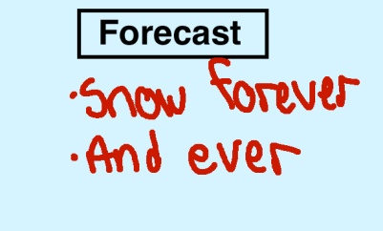
Content of presentation
Conclusions
Why ?
1 Emphasis on robust demand analysis in legislation and guidance
2. What is demand analysis used for ?
What is needed ?
3. What modelling do I need ?
4. Data, surveys and evidence
5. Forecasting the Future
Implementation
6. Procuring, operating and maintaining models

Slide 17
5. Forecasting the future
Rational Demand Forecast
Scenarios to deal with Uncertainty
Longer-term : less precise
Reaction of the Model to the plan/project (options)
Key external variables e.g.
GDP
Developments of O+Ds (migration+land-use/economic policy etc.)
Explanatory external model of the future
History-future regression
Elasticities from other places
Expert polling ?
Reaction of the Model to
Future capacity constraints
Policy changes
Future infrastructure development
Changes in travel costs

Slide 18


Content of presentation
Conclusions
Why ?
1. Emphasis on robust demand analysis in legislation and guidance
2. What is demand analysis used for ?
What is needed ?
3. What modelling do I need ?
4. Forecasting the Future
5. Data, surveys and evidence
Implementation
6. Procuring, operating and maintaining models

Slide 19
6. Procuring, operating + maintaining models
Institutional
Institutional Rules
Institutionalize required regular data collection / guidance / modelling
Models (+data) owned by the public sector
Make models and data openly available
Tendering Models
Models + data closely specified in ToR
Allow enough time and resources in study
Embed rules in contract
Institutional Capability
Buy/develop know-how to specify models/surveys
Outsource model building and maintenance if necessary
In-house model operations and survey capability best
Successful Demand Modelling
Route to quality / effective demand analysis

Slide 20
Demand modelling and EC requirements - SUMMARY
Conclusions
Why ?
EC legal requirements for robust demand analysis and rational forecasting
Robust realistic demand analysis in strategic and project development cycle is the way to cost-efficient, user-centered projects
What is needed ?
Model scope covering key project + future development impacts
Sufficient data/evidence
Forecast with rational basis
Transparent documentation
Key to institutional success
Develop the right institutional rules and capability
Ensure demand analysis is well specified in study tenders

Slide 21
Questions ?
More information:
http://jaspers.eib.org/

